Slide 1
Evaluation and improvement of a dual-channel method for the detection and quantification of high-temperature events on FireBIRD data
Penghua Li, October 04, 2017

Slide 2
Contents
Introduction and motivation
Introduction of MITIP, an atmospheric correction and image processing method
Short description of MITIP
Data preparation and pre-processing
Outcomes of the MITIP
Validation and improvement of the MITIP
Results comparison with MODIS SST and calibration
Transferability test (SST)
Results comparison with MODIS LST and calibration
Transferability test (LST)
Analysis of high-temperature events
High-temperature events
Comparison with the results of Zhukov’s algorithm
Conclusion and outlook

Slide 3
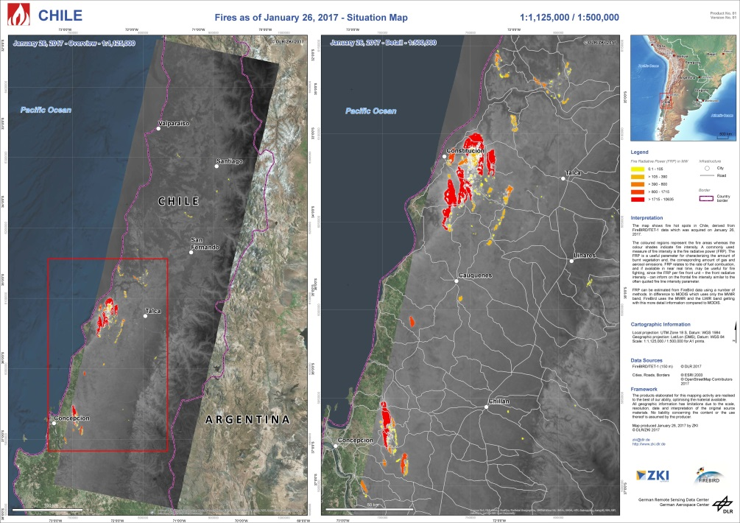
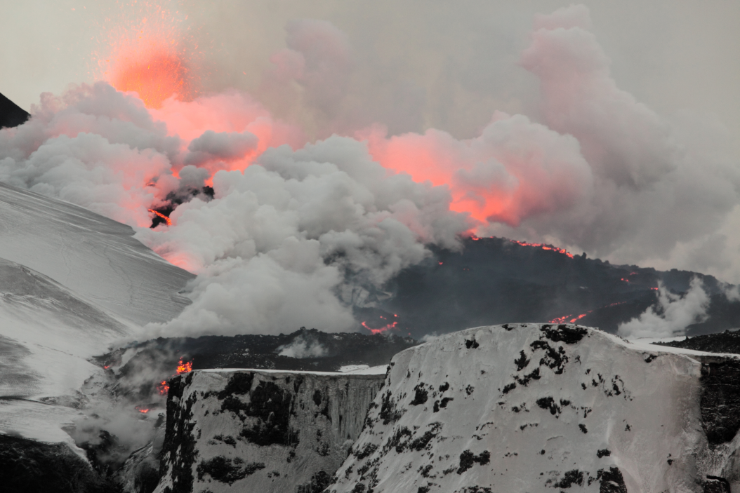
1. Introduction and motivation
High-temperature events (HTE), such as fire hazards and volcanic eruptions, occur widely all over the world and exert great impacts on the environment. Because of the huge areas affected by high-temperature events and its potentially dangerous characteristics, a critical role in the monitoring and investigating of HTE belongs to satellite remote sensing.
Chile wild fire
2010 eruptions of Eyjafjallajökull

Slide 4
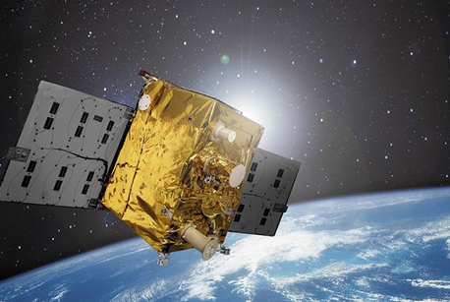
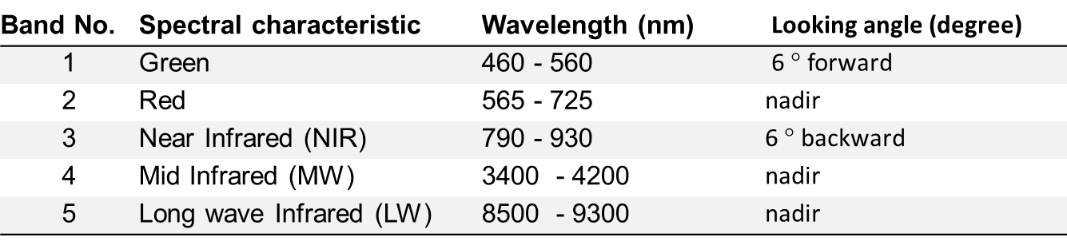
1. Introduction and motivation
FireBIRD satllite
Constellation of 2 tilting satellites :
TET-1 (launch July 2012),
BIROS (launch June 2016)
Orbit (sun-sychronus)
TET-1: 438 km (asc.), LTAN 13:50 UCT
BIROS: 510 km (desc.), LTAN 21:40 UCT
Sensors:
2 Infrared cameras with staggered detectors
One 3-channel VIS/ NIR - camera

Slide 5
2. Introduction of MITIP, an atmospheric correction and image processing method
The MITIP method is an atmospheric correction and image processing method developed by Dr.Rudolf at DLR, which is used for processing the thermal remote sensing imageries of the FireBIRD satellite.
Input data
Temperature retrieval
sub-pixel resolution temperature determination
Atmospheric correction

Slide 6
2. 2 Data preparation and pre-processing
Input of MITIP
TET-1 imagery with MIR and TIR band
ASTER Global Elevation Models
ASTER Global Emissivity Database
MODIS water vapor file
Requirement
Overlap
Same pixel size
Same num. of rows and col.
Pre-processing
Convert to GeoTIFF and reporject to appropriate UTM zone
Resamplint to pixel size 150 * 150
Using TET-1 scene as mask to clip other imageries

Slide 7
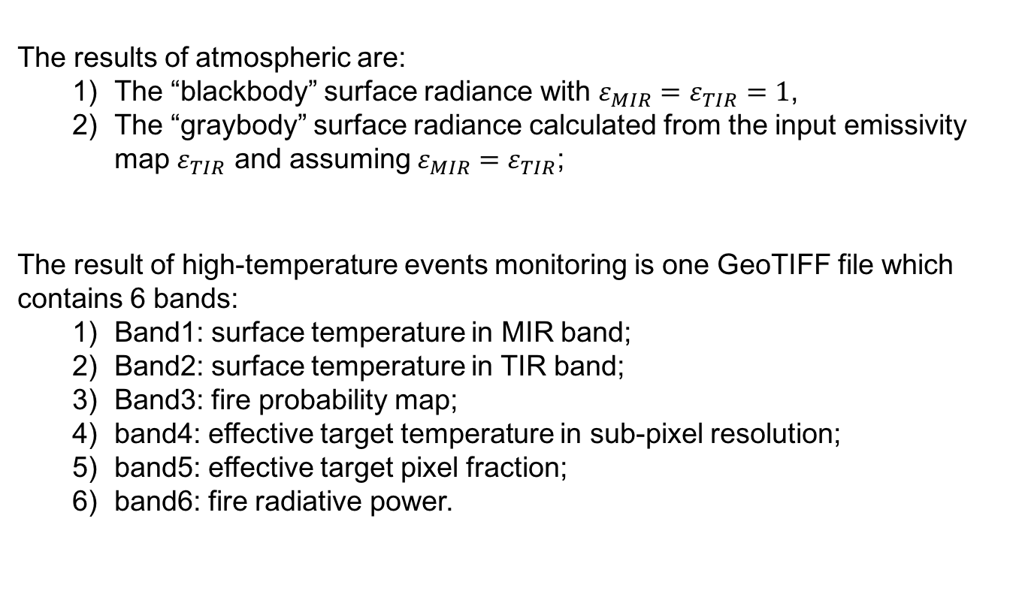
2. 3 Outcomes of the MITIP
The results of atmospheric are:
The “blackbody” surface radiance with $ε_{MIR}=ε_{TIR}=1$,
The “graybody” surface radiance calculated from the input emissivity map $ε_{TIR}$ and assuming $ε_{MIR}=ε_{TIR}$;
The result of high-temperature events monitoring is one GeoTIFF file which contains 6 bands:
Band1: surface temperature in MIR band;
Band2: surface temperature in TIR band;
Band3: fire probability map;
band4: effective target temperature in sub-pixel resolution;
band5: effective target pixel fraction;
band6: fire radiative power.

Slide 8
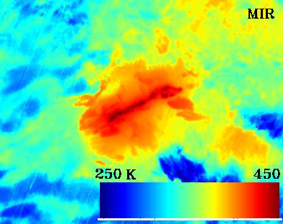
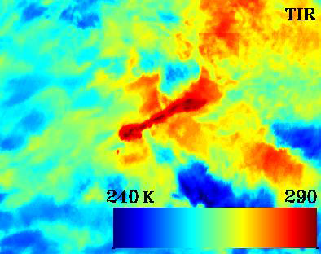
2. 3 Outcomes of the MITIP
Example: Bardarbunga 2014.09.14
Surface temperature map (MIR)
Surface temperature map (TIR)

Slide 9
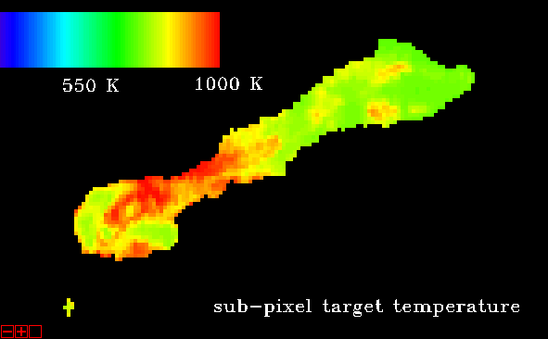
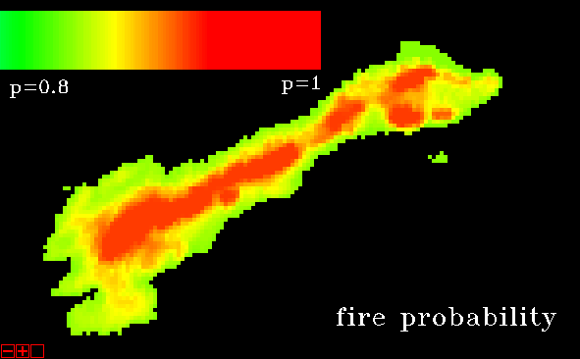
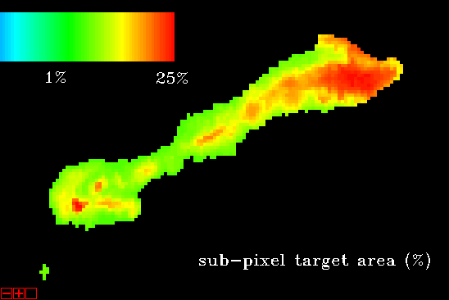
2. 3 Outcomes of the MITIP

Slide 10
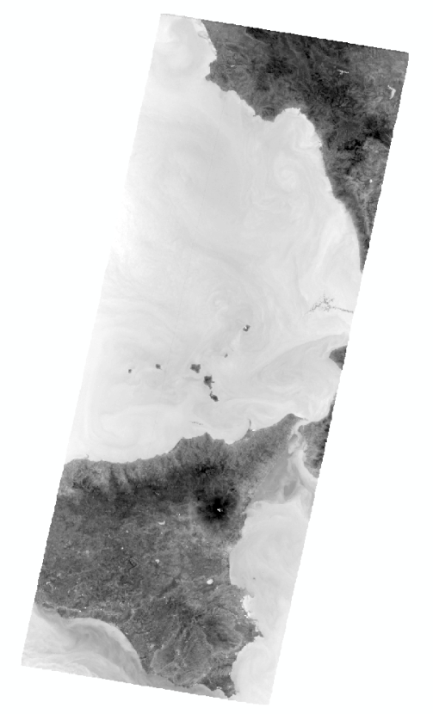
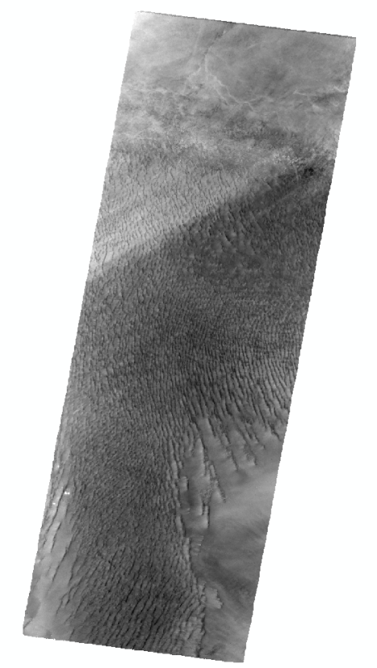
3. Validation and improvement of the MITIP
To see whether the temperature results derived from the MITIP are reliable or not, firstly we compare them with MODIS Sea Surface Temperature (SST) and MODIS Land Surface Temperature (LST) respectively.
Here we select two test sites whose imageries mainly covered by sea (Etna) and homogeneous landscape (Libya) respectively.
Etna:
Libya-1:

Slide 11
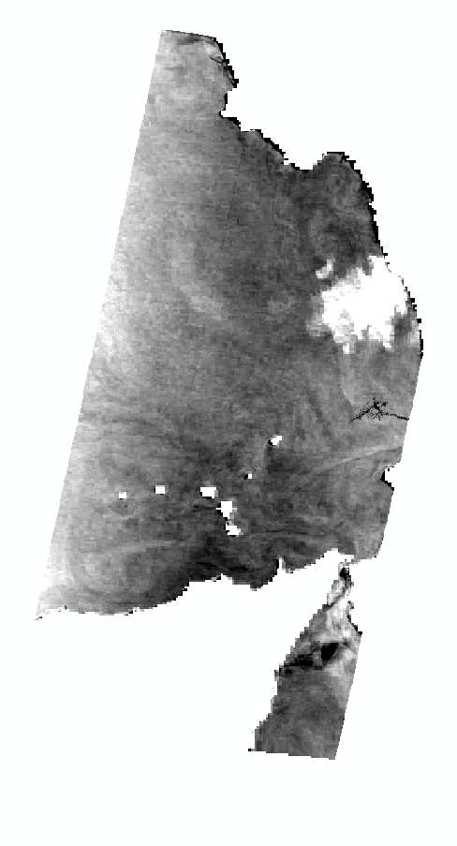
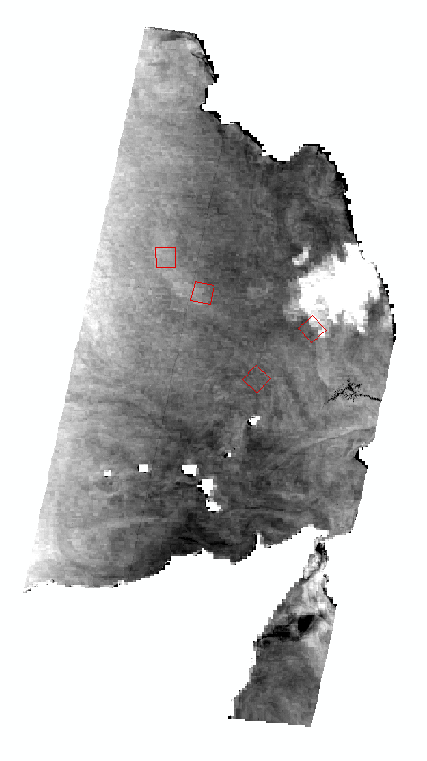
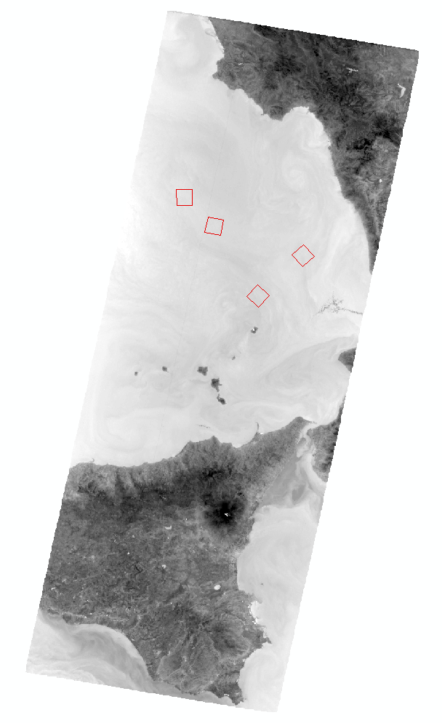
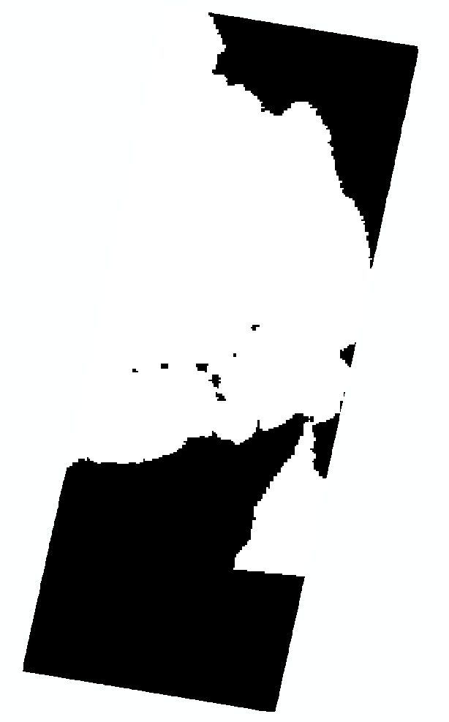
3. Validation and improvement of the MITIP
The comparisons are done as follows (Etna as example):
4
5
Outliers are filtered out and mean temperature difference calculation.
Computing mean temperature differences over all sub-areas.
Pre-processing of the MODIS SST
1
2
Image subtraction
3
Selection of several (3 – 5) sub-areas.

Slide 12
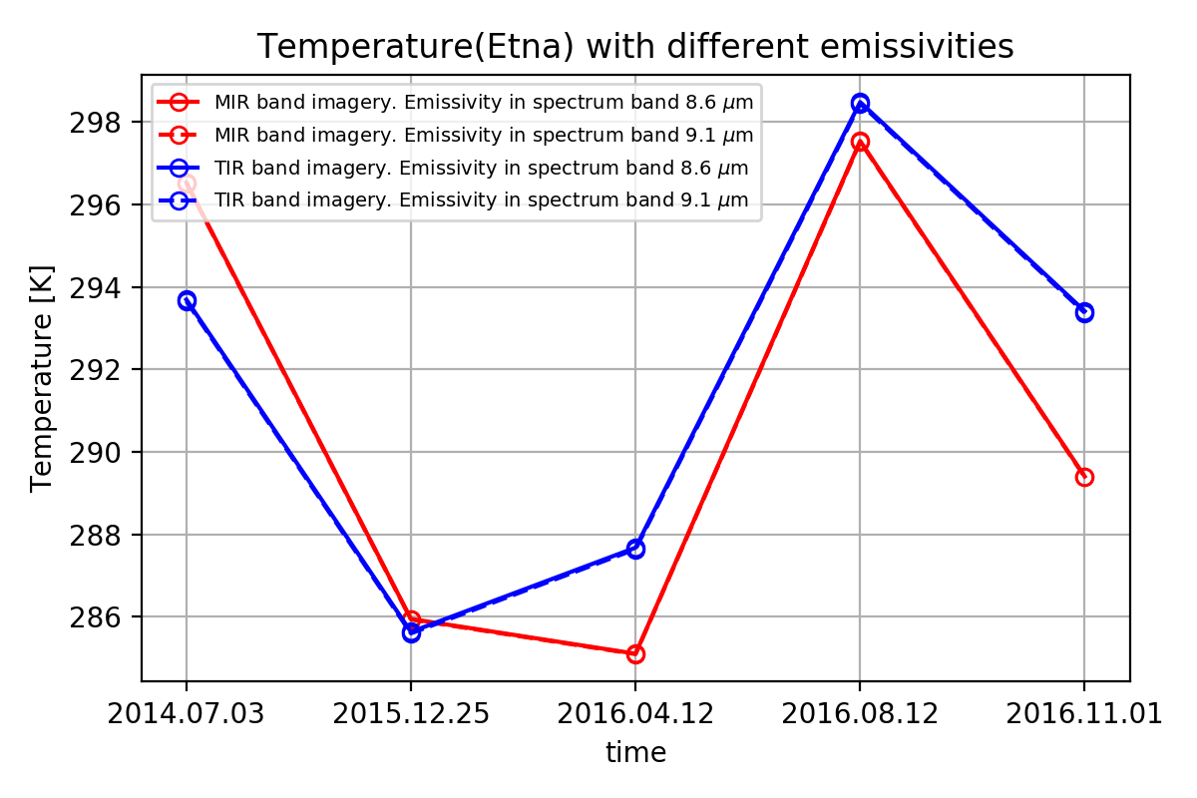
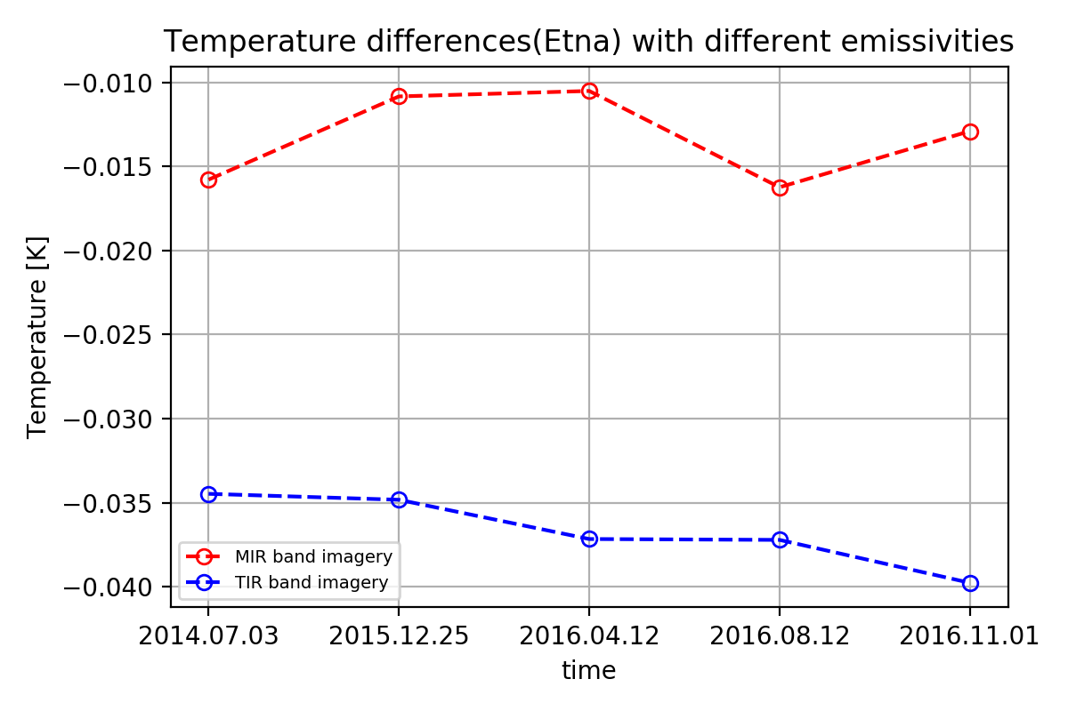
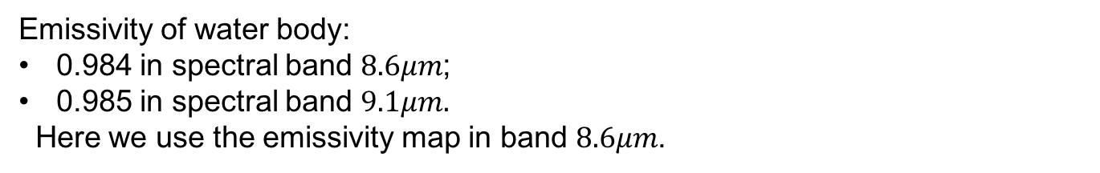
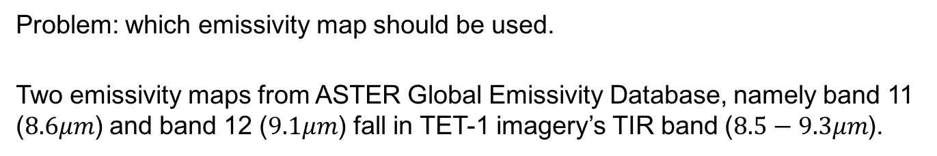
3.1 Results comparison with MODIS SST and calibration
Problem: which emissivity map should be used.
Two emissivity maps from ASTER Global Emissivity Database, namely band 11 ($8.6μm$) and band 12 ($9.1μm$) fall in TET-1 imagery’s TIR band ($8.5−9.3μm$).
Emissivity of water body:
0.984 in spectral band $8.6μm$;
0.985 in spectral band $9.1μm.$
Here we use the emissivity map in band $8.6μm$.

Slide 13
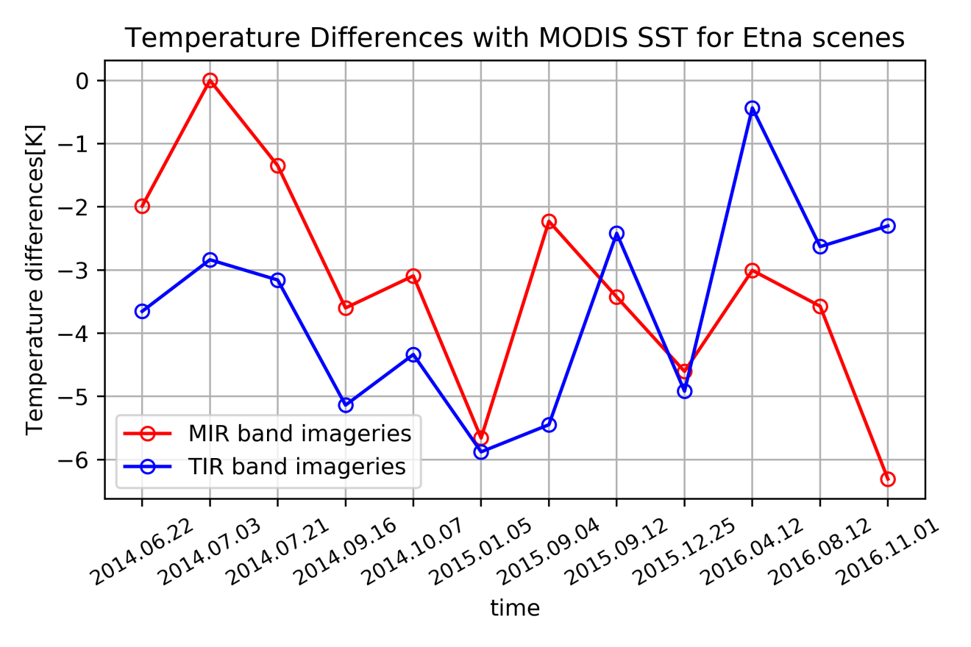
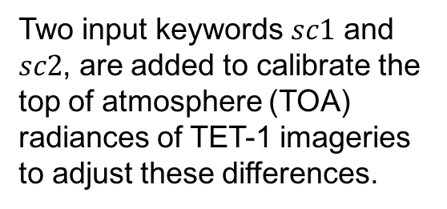
3.1 Results comparison with MODIS SST and calibration
Firstly, the temperature results from MITIP are compared with MODIS SST.
Two input keywords $sc1$ and $sc2$, are added to calibrate the top of atmosphere (TOA) radiances of TET-1 imageries to adjust these differences.

Slide 14
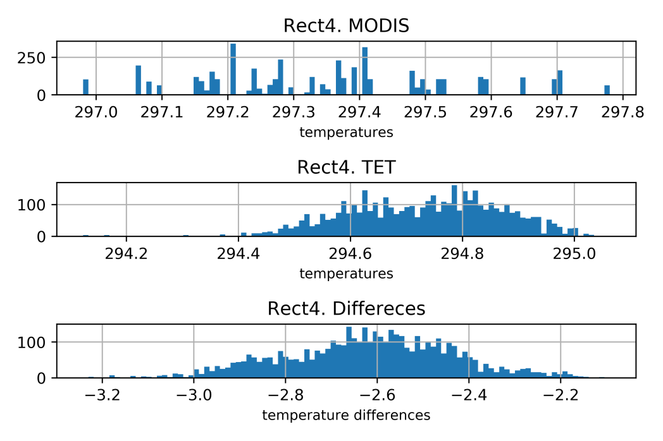
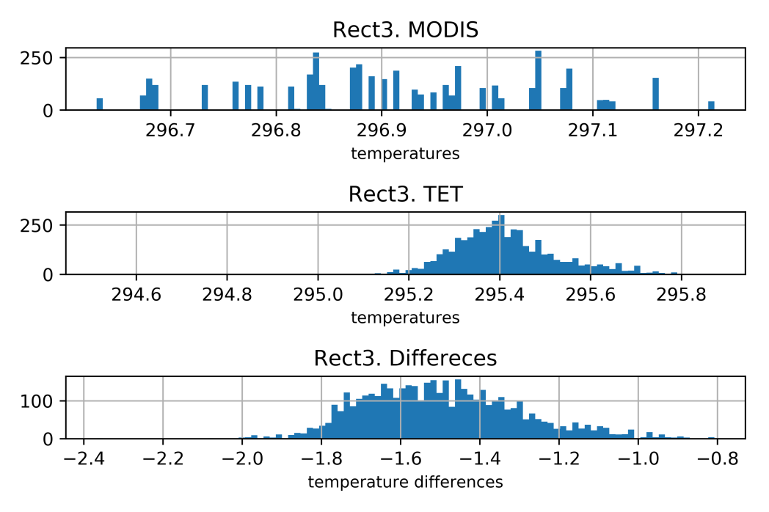
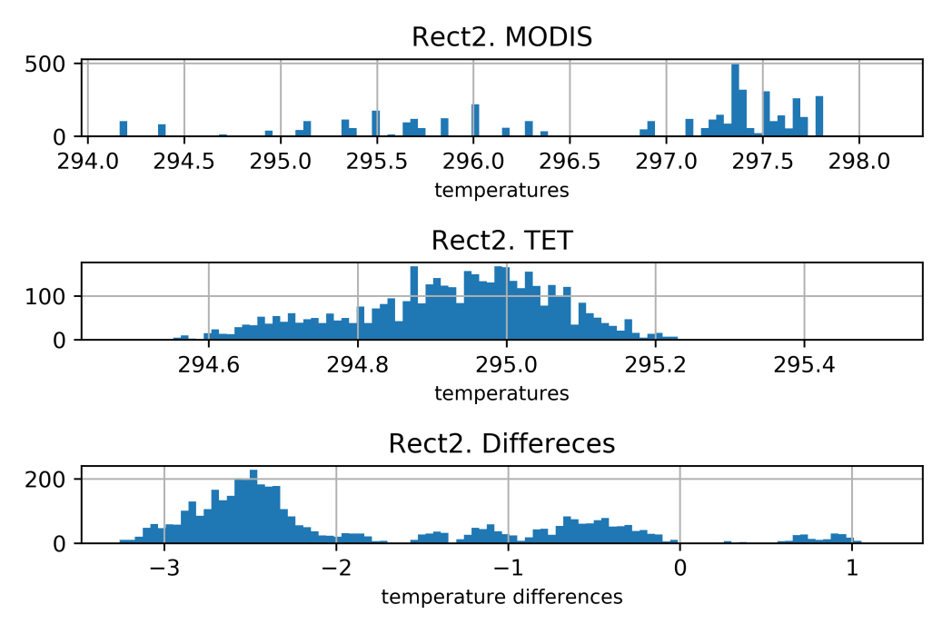
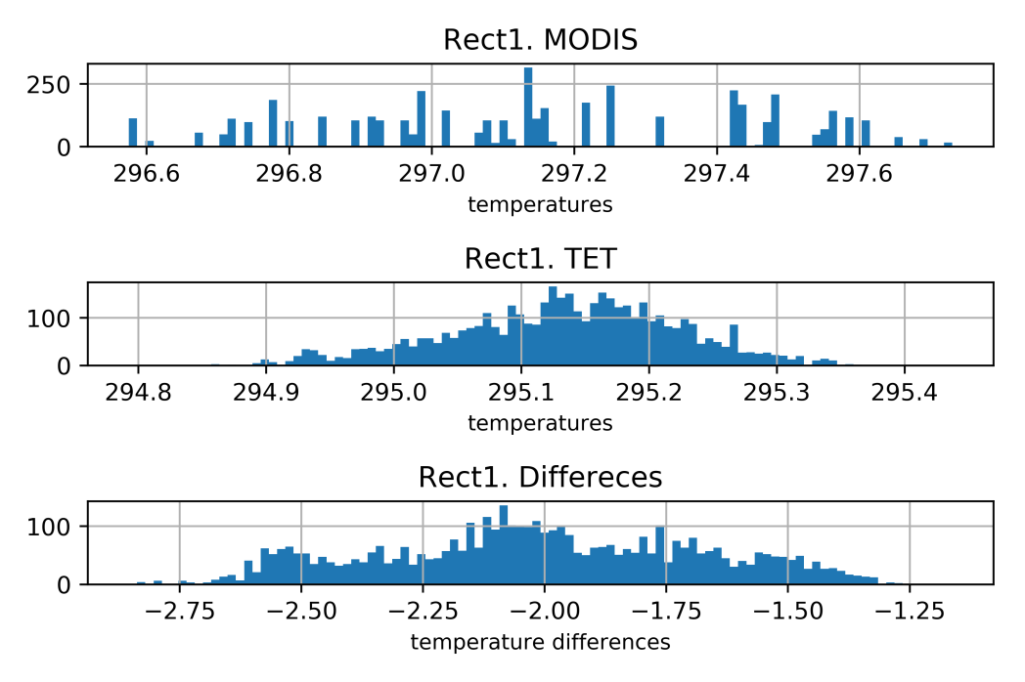
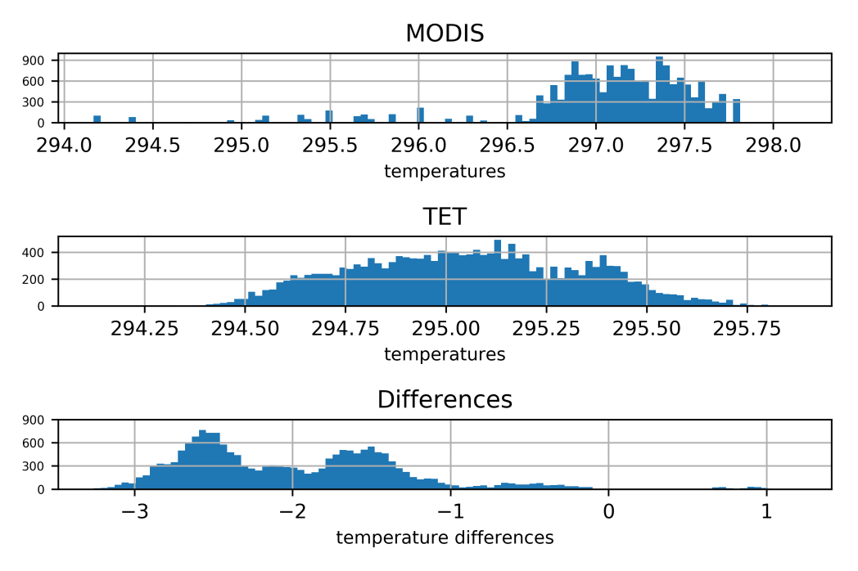
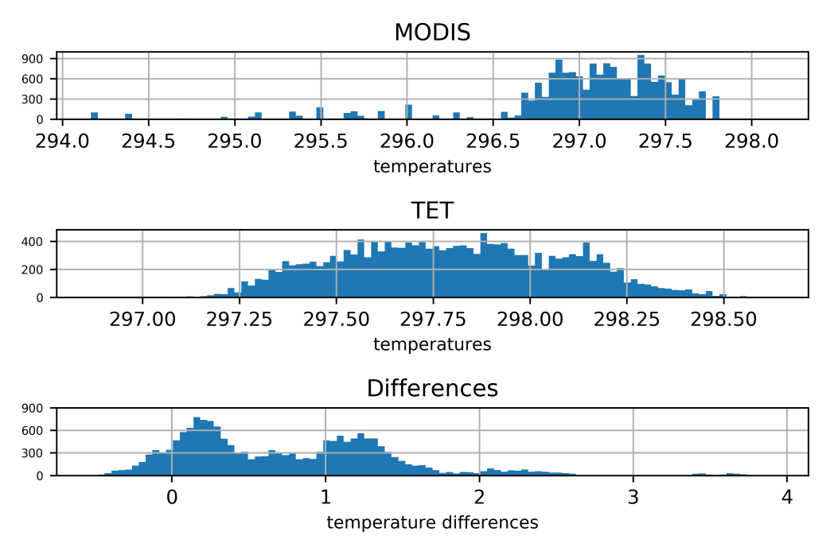


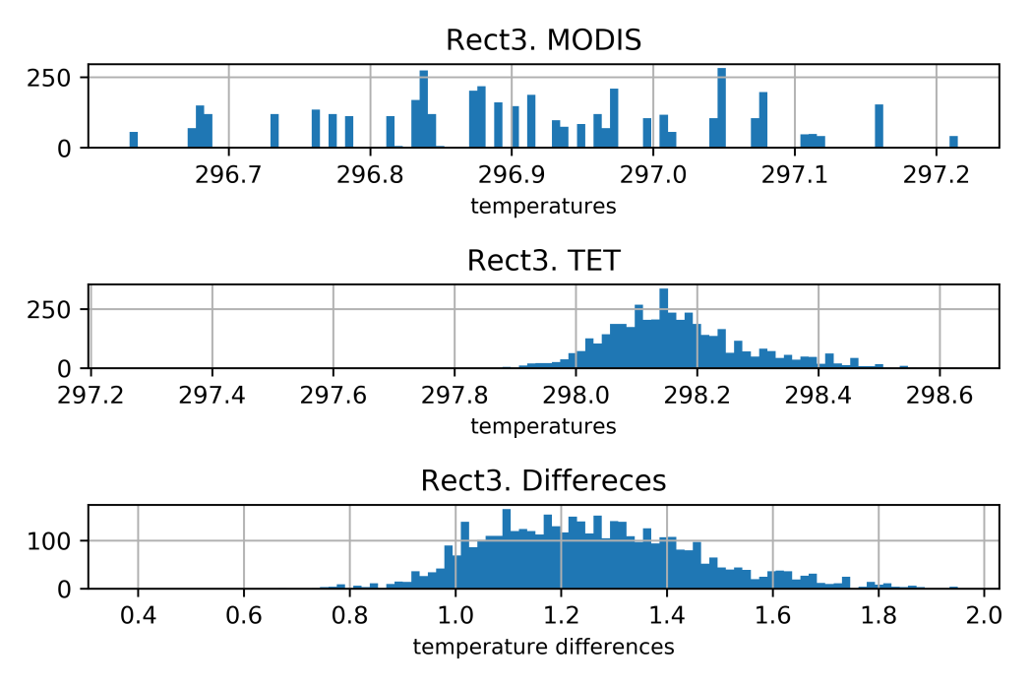
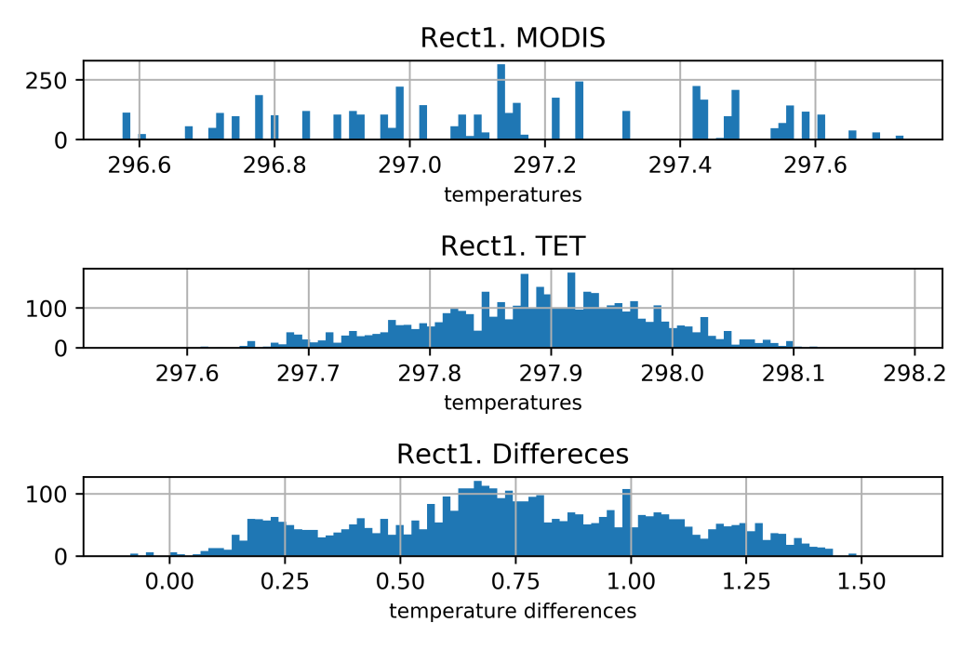
3.1 Results comparison with MODIS SST and calibration
Five scale factors are selected, namely 1.00 (original TOA radiances), 1.05 (increase the TOA radiances by 5%), 1.10, 1.15, 1.20, for each band.
Scale factor 1.00
To see how the scale factor will affect the results of the MITIP, the histograms of the sub-areas in the surface temperature map of MIR band with different scale factors are investigated.
Scale factor 1.10

Slide 15
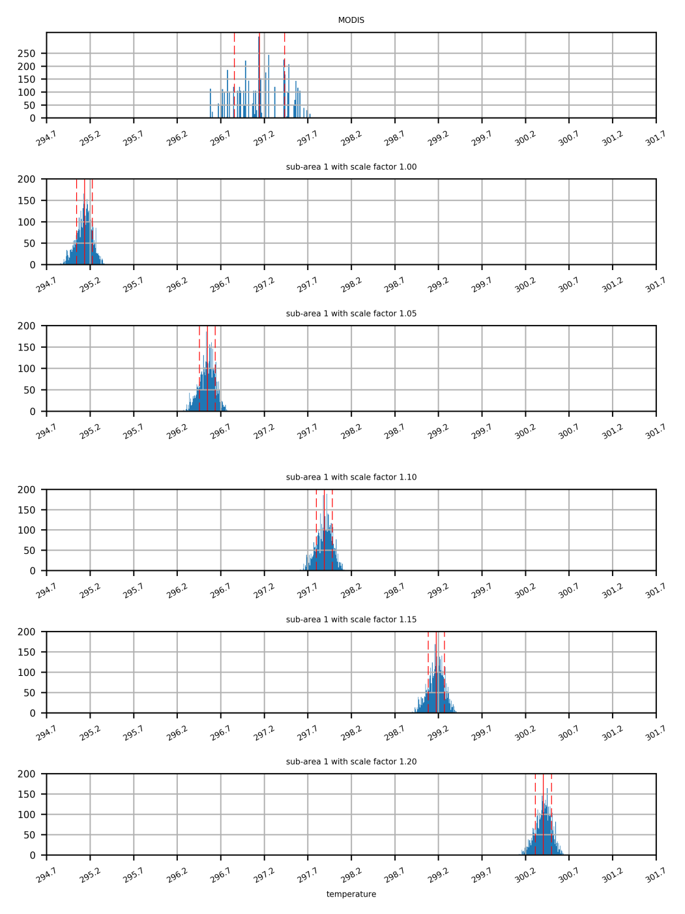
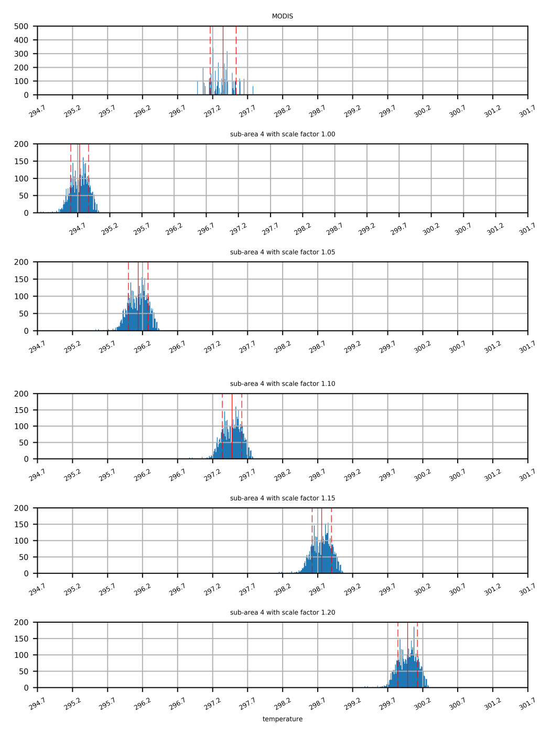
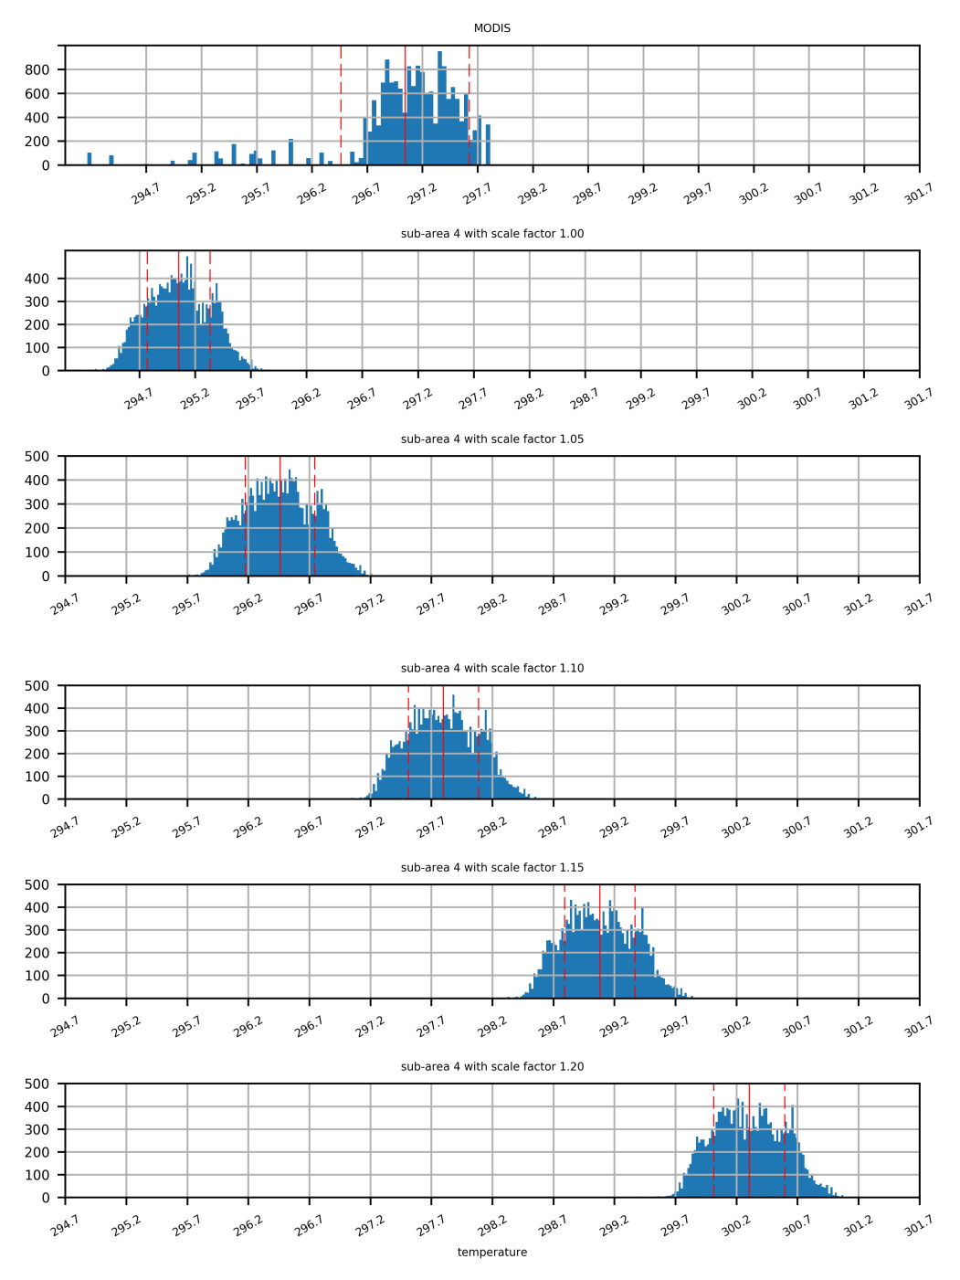
3.1 Results comparison with MODIS SST and calibration
The histograms of sub-area 1 and sub-area 4 with all the five scale factor are shown on the right.
The histogram of all pixels inside the 4 sub-areas are plotted.
Sub-area 1
Sub-area 4
Sub-area All

Slide 16
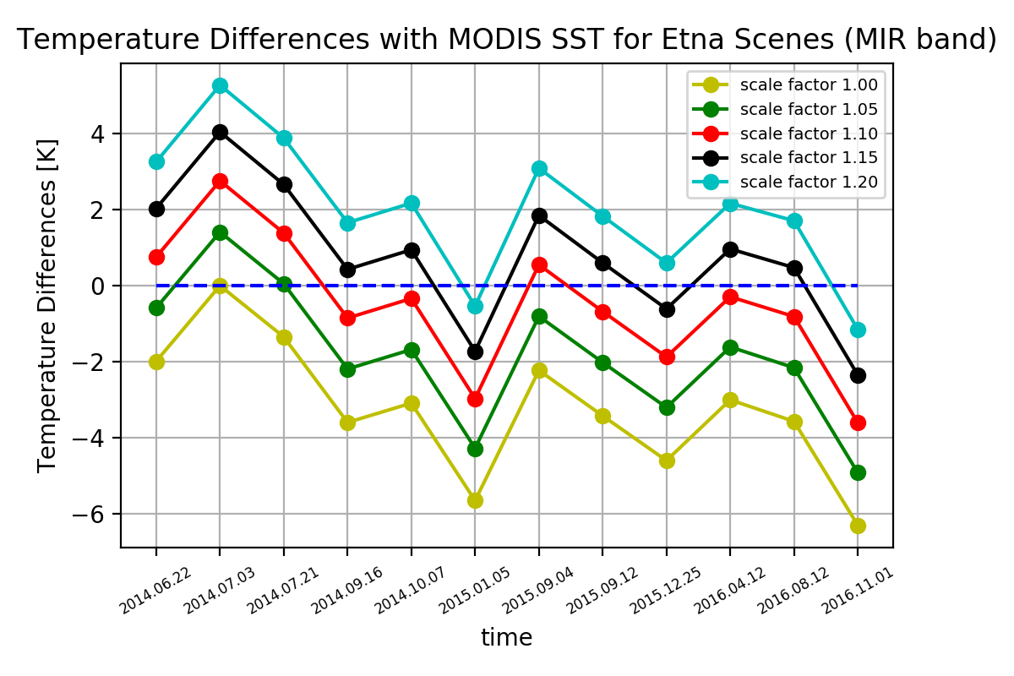
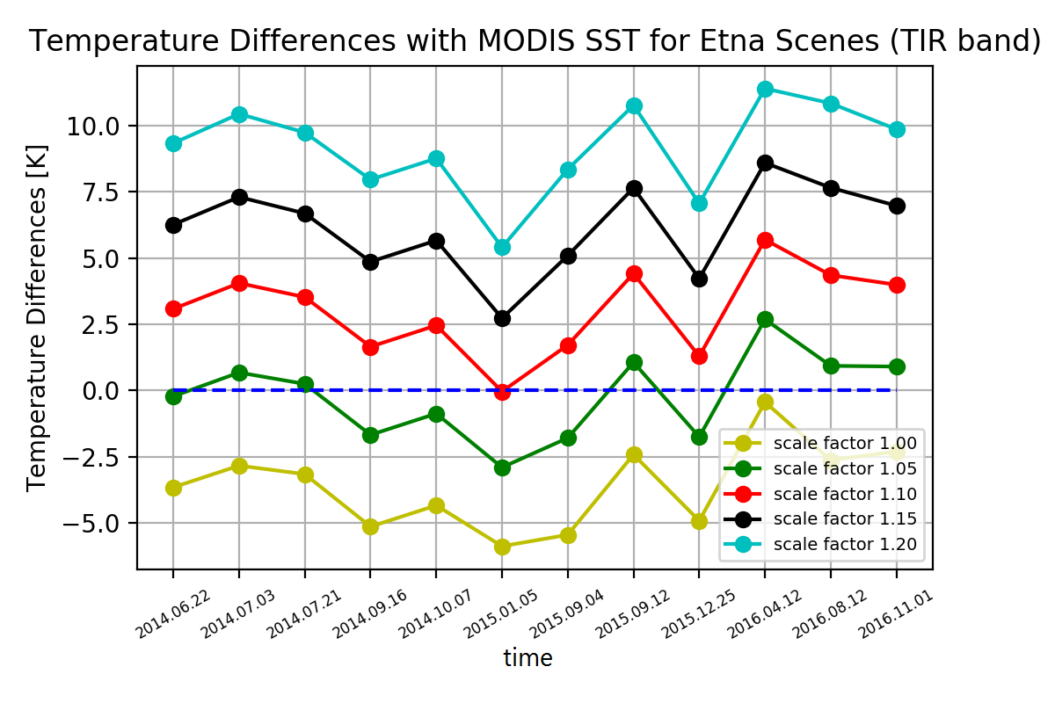
3.1 Results comparison with MODIS SST and calibration
The mean temperature difference over all the sub-areas is able to represent the temperature differences.
So in order to investigate a bunch of TET-1 scenes and do a time-series analysis, the method presented before which computes the mean temperature difference over all selected sub-areas are used.

Slide 17
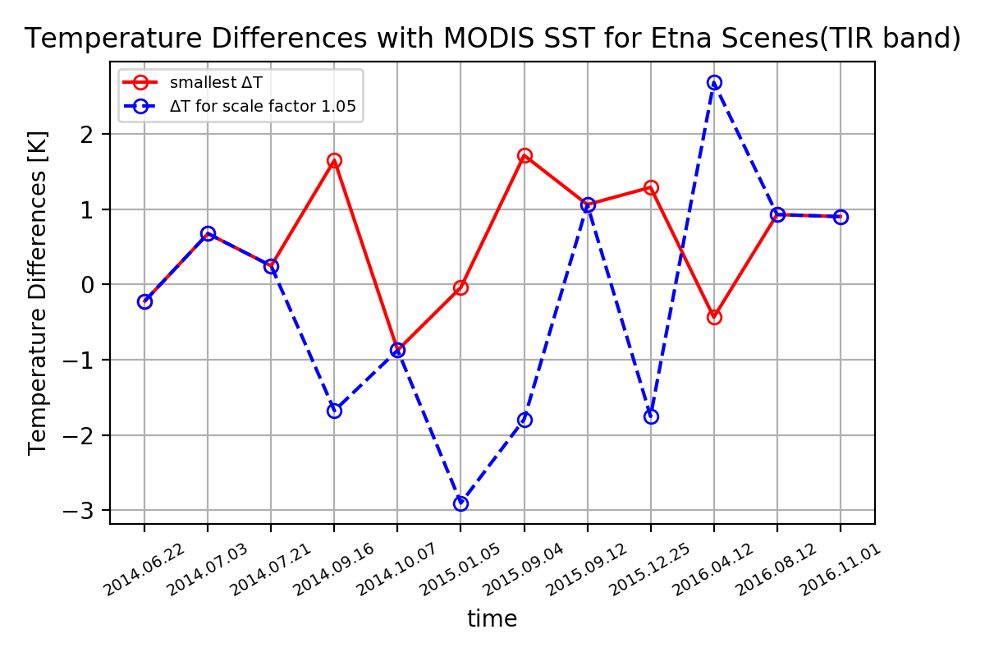
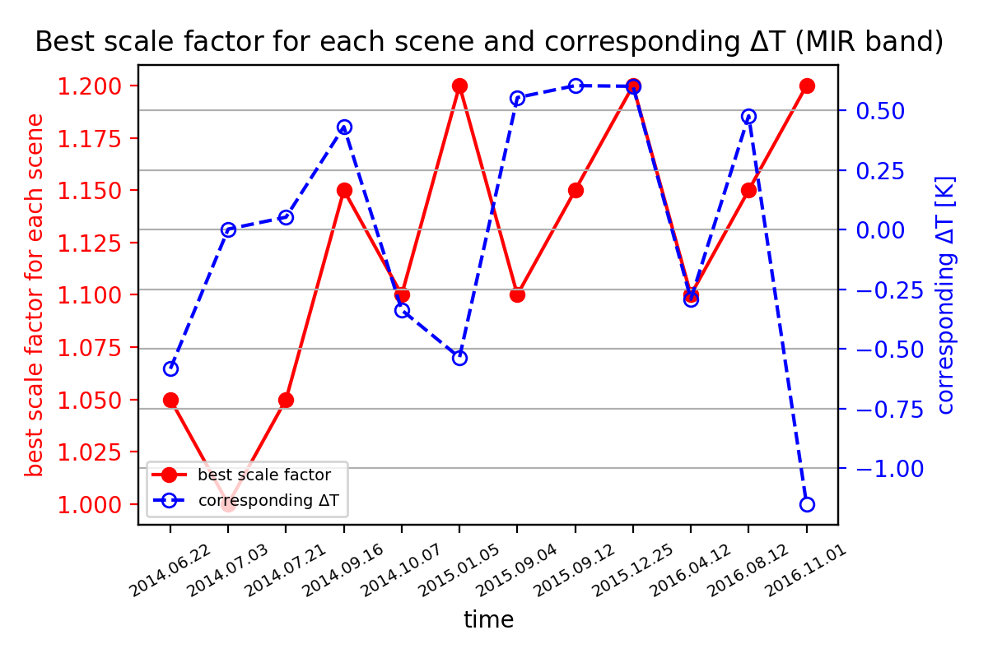
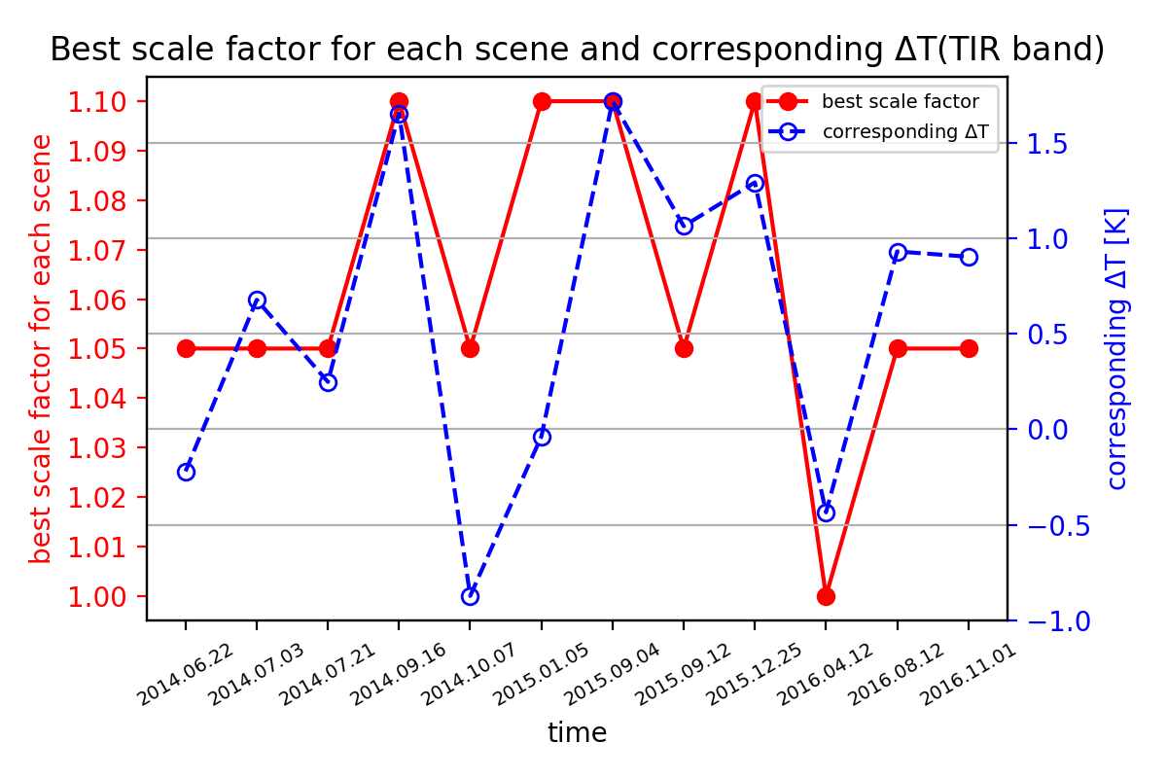
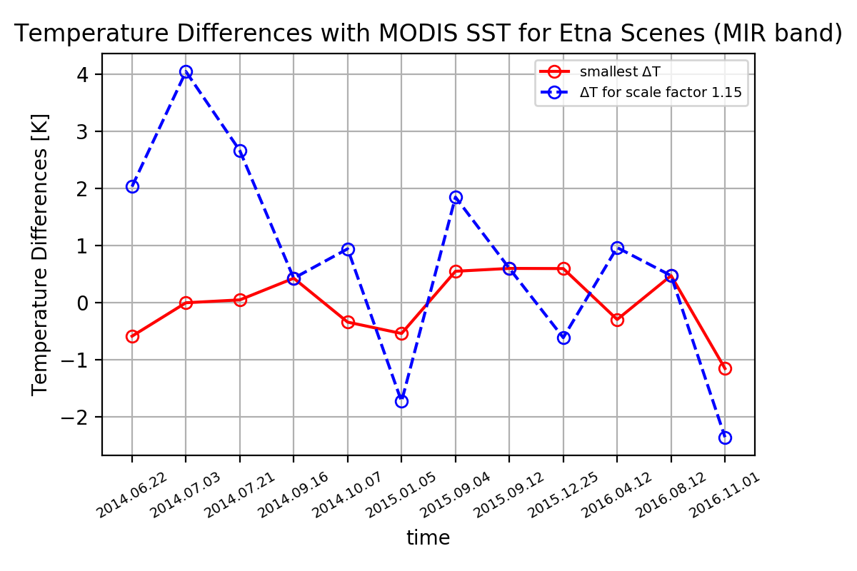
3.1 Results comparison with MODIS SST and calibration
The optimal scale factor for each band and its corresponding temperature difference $∆T$ is showed below.
According to the comparison results and analyses, the optimal scale factor for MIR band is chosen as 1.15 and for TIR band1.05.

Slide 18
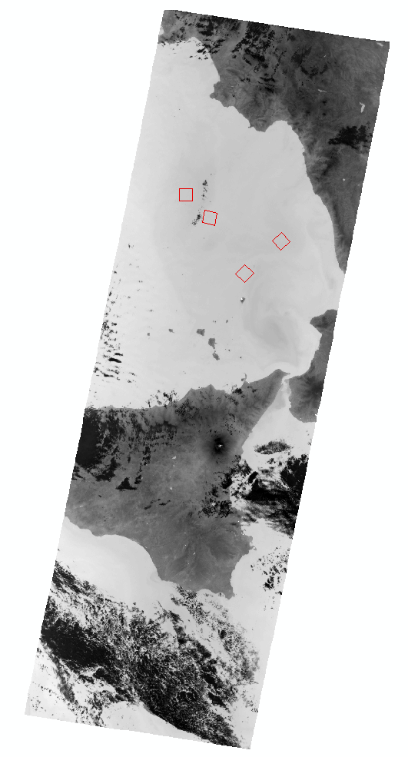
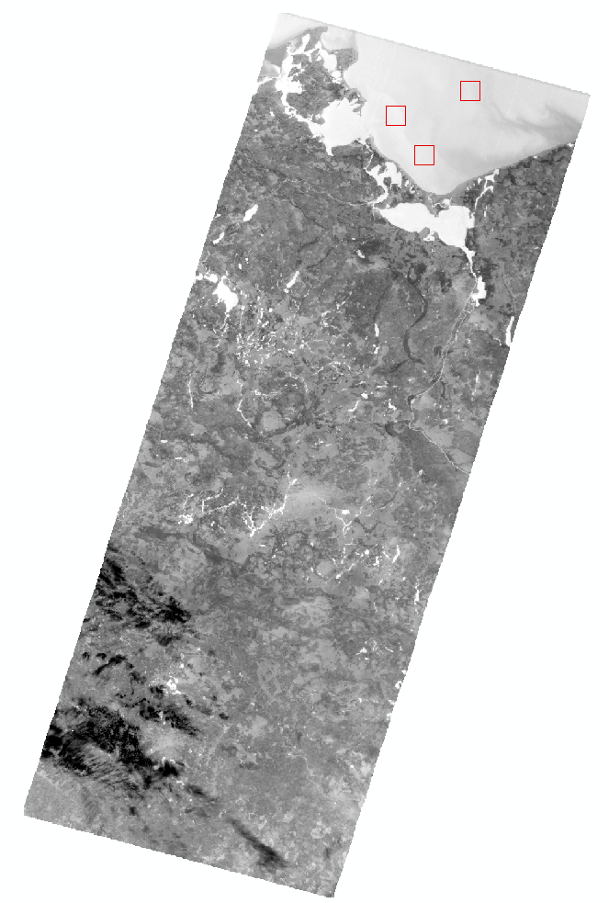
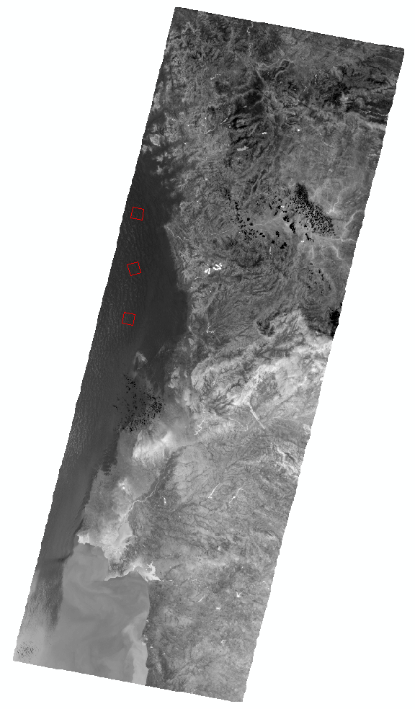
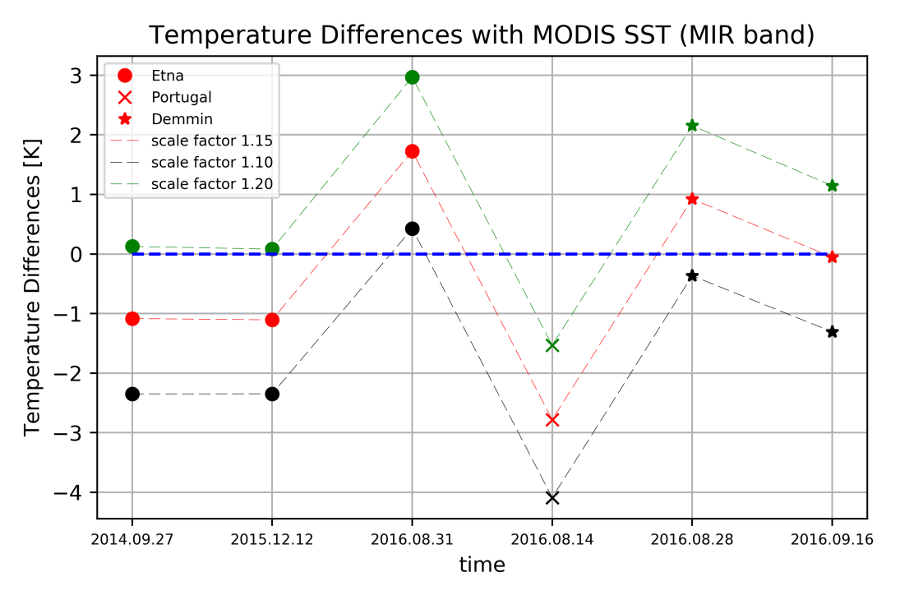
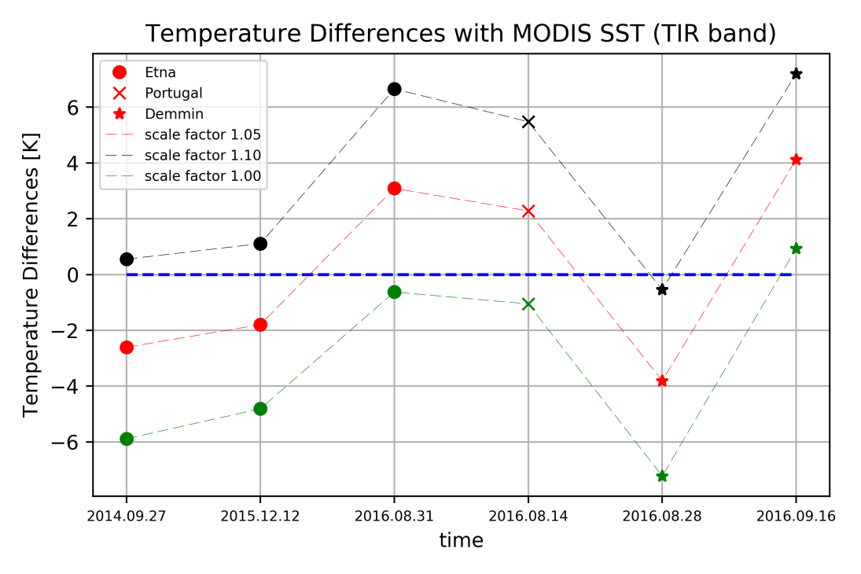
3.2 Transferability test (SST)
The chosen scale factor should be tested with different TET-1 imageries. Here, it is tested using scenes of Etna, Demmin and Portugal as showed bellow.

Slide 19
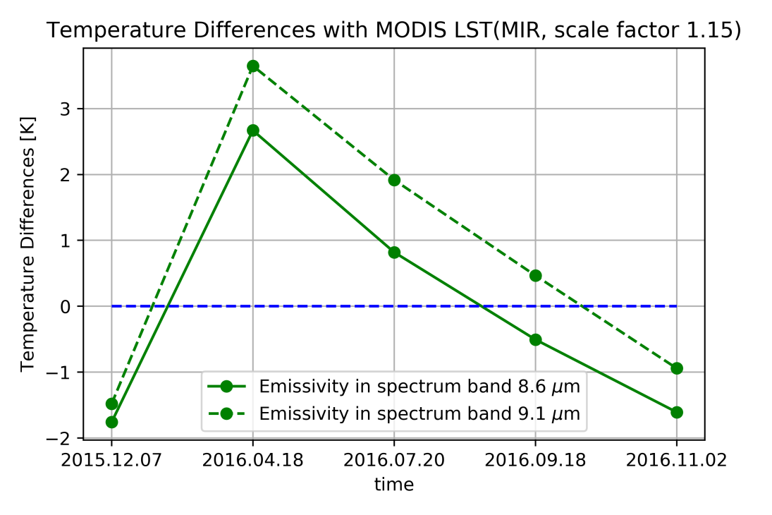
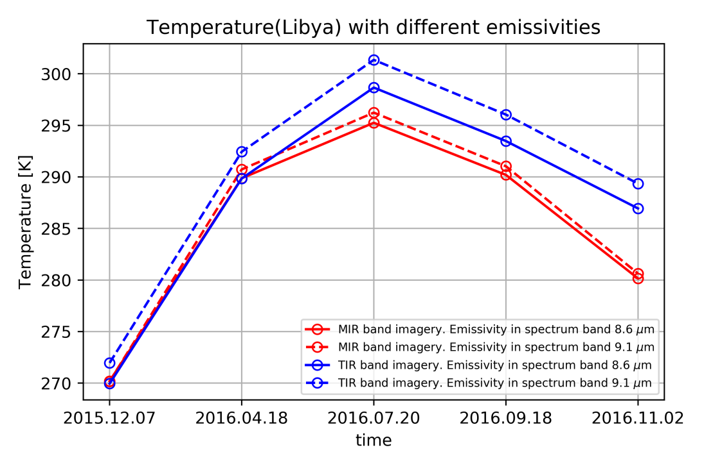
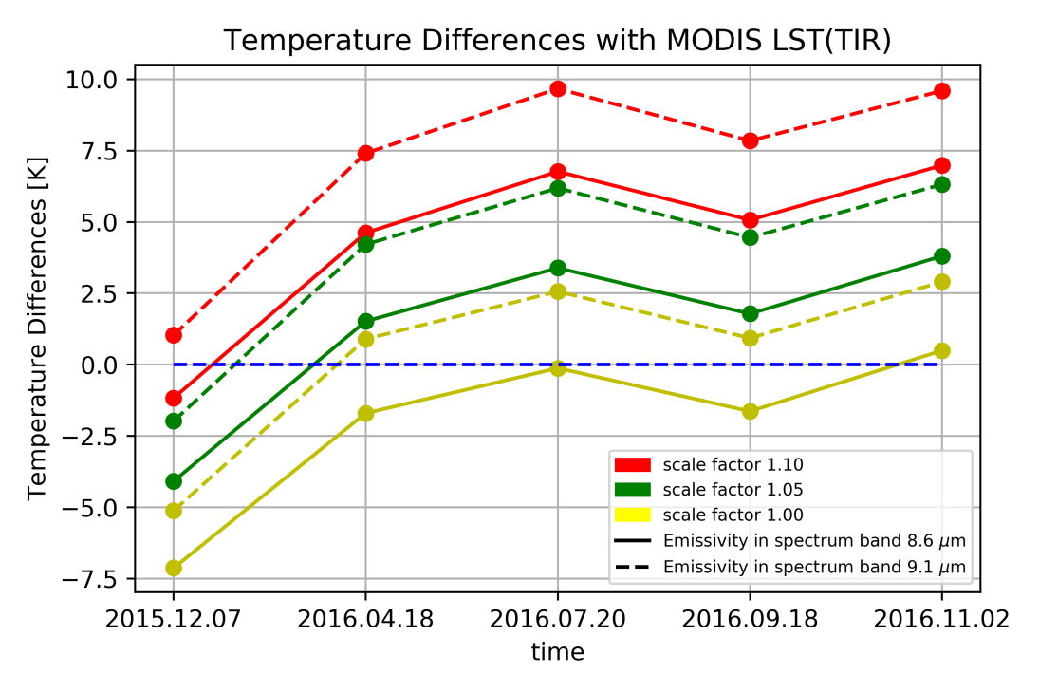
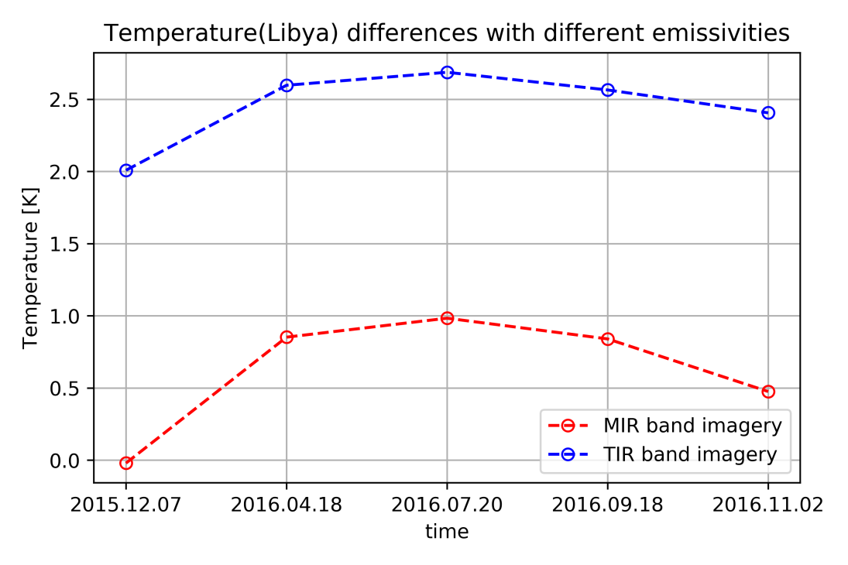
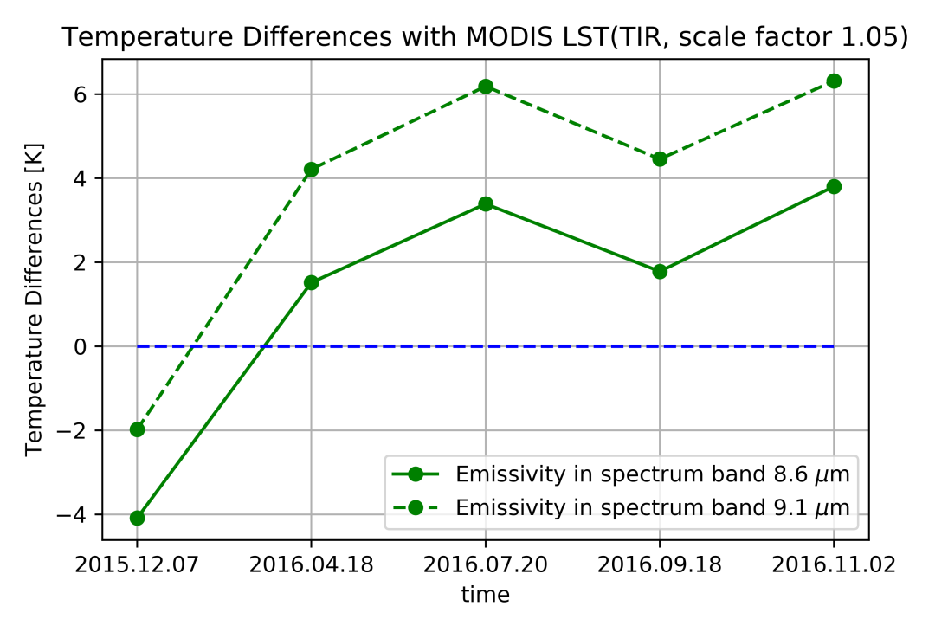
3.3 Results comparison with MODIS LST and calibration
For the comparison with MODIS LST scenes of Lybia-1 are used.
Problem again: which emissivity map should be used.

Slide 20
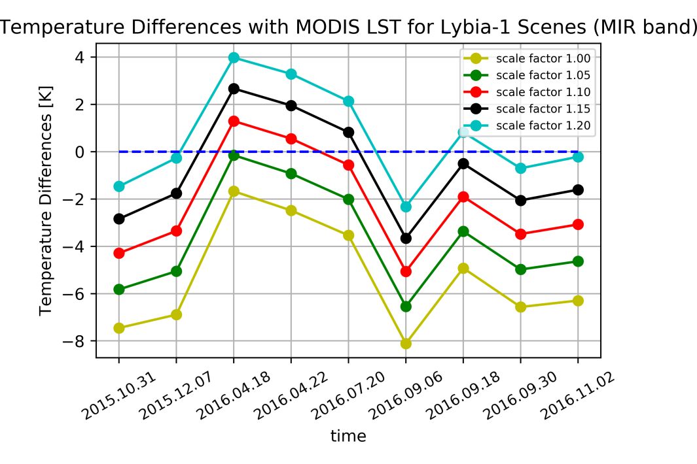


3.3 Results comparison with MODIS LST and calibration
Similarly, 5 sub-areas are chosen to do the comparison as showed in the picture on the right.
And different scale factors (1.00, 1.05, 1.10, 1.15, 1.20) are used to see the differences between the temperature results from MITIP is compared with MODIS LST.

Slide 21





3.3 Results comparison with MODIS LST and calibration
We can see that this situation is very similar with the comparison with the MODIS SST. The optimal scale factor for each band and its corresponding temperature difference $∆T$ is showed below.
According to the comparison results and to keep consistence, the optimal scale factor for MIR band is chosen as 1.15 and for TIR band it is 1.05 as well.

Slide 22



3.4 Transferability test (LST)
The chosen scale factor would be tested with different TET-1 imageries. Here, it is tested using scenes of Libya-2.

Slide 23
4. Analysis of high-temperature events
Optimal scale factor:
1.15 for MIR band imagery;
1.05 for TIR band imagery.
Now, we are able to analyse the performances of MITIP on the monitoring of high-temperature events (HTE).
Firstly the results of the MITIP of the high-temperature monitoring is presented.

Slide 24




4.1 High-temperature events
Etna 2014.06.22

Slide 25





4.1 High-temperature events
Stromboli 2014.06.22

Slide 26





4.1 High-temperature events
Bardargunga 2014.09.14

Slide 27





4.1 High-temperature events
Portugal 2016.08.11

Slide 28
4.2 Comparison with the results of Zhukov’s algorithm
The Zhukov’s algorithm is the algorithm used to process the TET-1 imagery originally.
Atmospheric correction
threshold determination
cluster-based analysis
filtering out clouds, warm surface etc
Hot pixels detection
But the MITIP method performs a pixel-based analysis. Consequently, to do the comparison, a procedure is developed to shift the MITIP’s original pixel-based results to cluster-based results.
Input fire products
Extract every polygon feature
Extract AOI
Convert effect target temperature to a vector file
Create mask file
Zonal stastics

Slide 29

4.2 Comparison with the results of Zhukov’s algorithm
Etna 2014.07.21
Method | Temperature [K] |  |  | Cluster size
Zhukov | Min | Mean | Max | 127
 | 611 | 633.5 | 661.3
MITIP | 644.3 |  |  | 123

Slide 30

4.2 Comparison with the results of Zhukov’s algorithm
Stromboli 2014.07.03
Method | Temperature [K] |  |  | Cluster size
Zhukov | Min | Mean | Max | 16
 | 504.6 | 529.9 | 564.9
MITIP | 521.0 |  |  | 20

Slide 31

4.2 Comparison with the results of Zhukov’s algorithm
Bardarbunga 2014.09.14
method | Temperature [K] |  |  | Cluster size
Zhukov | Min | Mean | Max | 2461
 | 646 | 653.8 | 662
MITIP | 661.3 |  |  | 2025

Slide 32


4.2 Comparison with the results of Zhukov’s algorithm
Chile 2017.01.26
loc | method | Temperature [K] |  |  |  |  |  |  |  | Cluster size
a | Zhukov | Min |  | Mean |  |  |  | max |  | 1804
 |  | 635.2 |  | 641.4 |  |  |  | 648.1
 | MITIP | 656.7 |  |  |  |  |  |  |  | 2046
b | Zhukov | Min |  |  | Mean |  | Max |  |  | 3846
 |  | 617.6 |  |  | 626.9 |  | 637
 | MITIP | 602.0 |  |  |  |  |  |  |  | 4500
c | Zhukov |  | Min |  |  | Mean |  |  | max | 3863
 |  | c1 | 612 |  |  | 615.2 |  |  | 618.5
 |  |  |  |  |  |  |  |  |  | 3185
 |  | c2 | 612.9 |  |  | 619.9 |  |  | 627.5
 | MITIP | 625.0 |  |  |  |  |  |  |  | 7829

